Slide 1
RFM ANALYSIS
Presented by Joan Waithera

Slide 2
Overview
The data presented is that of a year
The RFM Analysis conducted for the data is divided into quartiles where with the groupings there are segments
The Segments available are ordered from highest to lowest:
Best Customers
Loyal Customers
Potential Loyalists
Promising
Customers Needing Attention
At Risk
Can’t Lose Them

Slide 3

Key Metrics to watch
Out of our total 4342 the following observation points were made:
The average customer orders within a 90 days timespan
The average customer orders at around 90 times through a period of one year
The total monetary value brought by the total clients is 8 Million USD

Slide 4

Quartiles for Segmentation Foundation
With the earlier discussed quartiles the scales used above are 1 to 4
Hence the higher the better.
F_score: Frequecy Score
R_score: Recency Score
M_score: Monetary Value Score
In this case we frequency is the lowest performing while recency tops the list

Slide 5
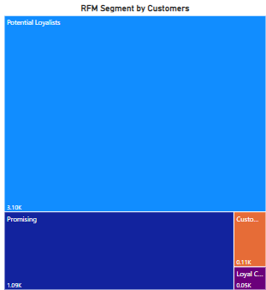
Online clientele fall in the mid spectrum
Our clientele occupy the 2nd to 5th positions in the RFM segments
Our leading numbers come from the 3rd and 4th RFM Segments
Whilst our trailing come from the 5th and 2nd RFM Segments

Slide 6
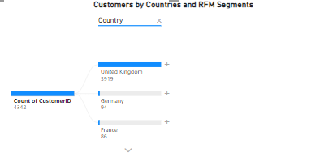
Big Disparity in Locations: United States in the lead with 90%
Most of our clientele comes from the United Kingdom followed by a big disparity difference from Germany and France

Slide 7
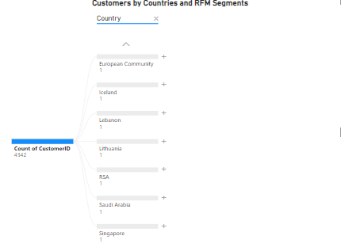
Are there markets we can tap into?
There could be markets that we could look into
The following countries have had just one customer over the last year

Slide 8
Recommendations
To increase the monetary score, consider offering tiered incentives for higher spending, like discounts on bulk purchases or exclusive access for high-spenders.

